Slide 1

Telco customer churn
Capstone project

Slide 2
Main idea
I have data set for Telco telecommunications company.
I want to predict if customer churn or not churn the company based on customer data.
I need to study the data in deep to know what should I do on it like cleaning, delete some columns, divide a column into more than one part, make some charts to see the relationship between columns.

Slide 3
The problem
Predict
Predict which customer will churn the company or will stay in the company based on customer data.
Build
Build machine learning models and in this project, I used Decision Tree and Random Forest models to predict churn column in data.
Compare
Compare between this two models to see which model give me the best accuracy.

Slide 4
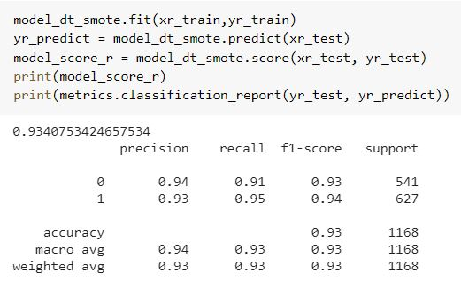
Results
After I studied the data and making some analysis on it, I built two models and there is the result for each model.
Decision Tree

Slide 5
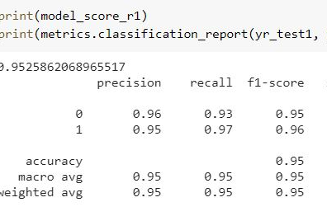
Continued Results
Random Forest

Slide 6

Thank you

